Slide 1

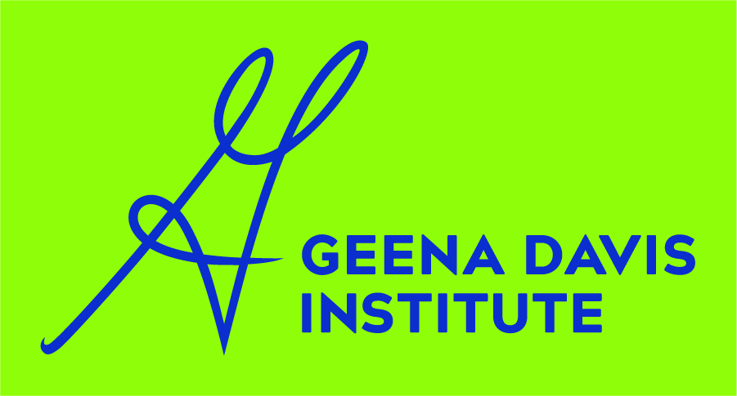
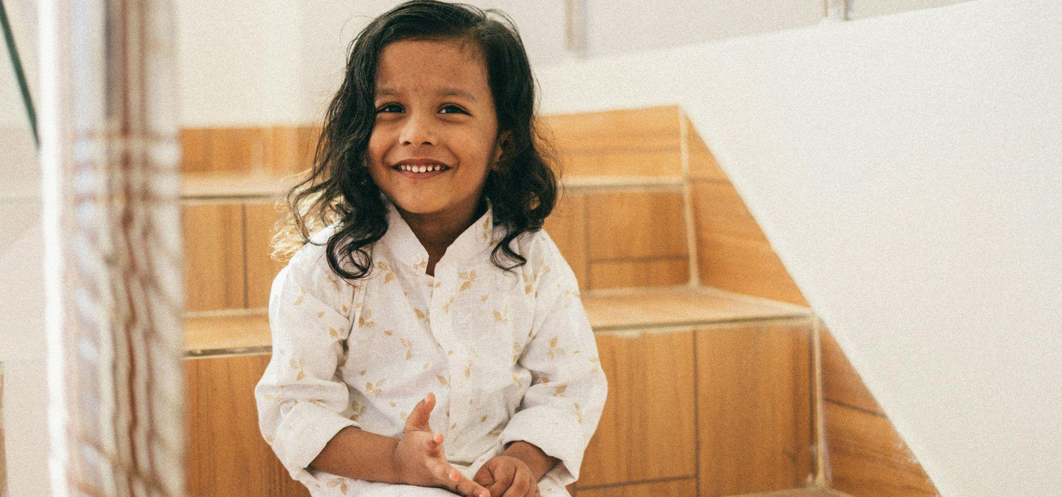
India Advertising Midline
Gender Representation and Inclusion Trends
07 July 2026
Notes:
Media, notably advertising, has the power not only to influence purchase decisions and behaviors but also to influence perceptions of gender norms among an impressionable, young audience. This makes it important to thoroughly understand what messages people are receiving from advertisements in India. In 2021, UNICEF India partnered with IAA and the Geena Davis Institute to study gender prevalence, stereotypes, tropes, and portrayals in the country’s most viewed advertisements. Overall, the study, which looked at data from 2019, found that advertisements reinforce gender stereotypes and tropes, such as more girls and women being shown in domestic roles or wearing revealing clothing, while boys and men were more often shown in work and leadership positions, and to have positive personal traits, like humor and intelligence. These gender gaps revealed not just differences in portrayal but an underlying imbalance in whose experiences and identities are centered in ads. The distance between how men and women are depicted in ads exposes an asymmetry in how ads communicate their social roles and value.
The purpose of this new midline study is to track progress or change in Indian advertisements since the 2021 report was released. This midline compares gender gaps in Indian advertisements from 2019 with gender gaps in advertisements from 2024. By systematically analyzing gender representation in advertising over time, this report will identify whether gender gaps and gender stereotypes have improved or stalled. Highlighting these patterns should inform creators and stakeholders, and lead to more balanced depictions of women and men, which, in turn, support the broader goal of promoting gender-sensitive advertising. This midline also compares the percent of female characters in particular roles in 2019 ads to 2024 ads, to account for ad narrative shifts among female characters.

Slide 2
Overview & methodology
Content analysis of 996 advertisements from 2024 that received the most reach in India, according to the India Chapter of the International Advertising Association
The unit of analysis for this study is the character, as in the actor shown on screen
We compare results from this study to the benchmark study from 2021
Year | Sample of advertisements | Total number of characters
2019 | 1,000 advertisements | 3,416 characters
2024 | 996 advertisements | 3,917 characters
Notes:
For this study, content analysis methodology was used, which is an objective, systematic, and quantitative analysis of mediated messages. Content analysis is the only quantitative method that allows for the analysis of major patterns and themes in mediated messages, like ads. Because the 2021 report also utilized content analysis methodology, this report’s findings are easy to compare and look at change over time.
The data analyzed in this report consists of 3,917 characters from 996 ads from 2024 that received the most reach in the country. Of these ads, 800 were television and 196 were digital. The ads were compiled and translated by the India Chapter of International Advertising Association.
The sample consisted of ads that received the most reach in India for two main reasons. First, for us to assess change from 2019, the sample of 2024 ads needed to be similar to those analyzed in the 2021 report, which looked at ads that received the most reach in the country. Second, in-depth analysis of ads with the most reach is attractive because it can help us understand what is most consumed in the country, thereby allowing us to get a more comprehensive understanding of what the population is exposed to. The analysis of 2024 ads is compared with the analysis of 2019 ads, collected in a previous study titled “Gender Bias and Inclusion in Advertising in India.” In the 2021 report, the data set consisted of 3,416 characters from 1,000 ads.

Slide 3
Lessons Learned and Good Practices
Notes:
When “Voice of Change” started, the baseline study and our ongoing engagement with clients, advertisers, and agencies in the advertising industry have already provided valuable lessons and good practices that can help shape future programs and organizational learning. We highlight these practices below:

Slide 4
Establishing a Clear Baseline
The baseline study set a crucial foundation by identifying existing gender stereotypes and gaps in advertising content, which has enabled more focused discussions and interventions.
Notes:
Establishing a Clear Baseline: The baseline study set a crucial foundation by identifying existing gender stereotypes and gaps in advertising content, which has enabled more focused discussions and interventions.

Slide 5
Industry Collaboration is Key
Continuous engagement through agency roadshows, panel discussions, and workshops has fostered awareness and encouraged ownership of gender sensitivity among creative professionals and decision-makers.
Notes:
Industry Collaboration is Key: Continuous engagement through agency roadshows, panel discussions, and workshops has fostered awareness and encouraged ownership of gender sensitivity among creative professionals and decision-makers.

Slide 6
Importance of a Detailed
Coding Framework
The baseline's comprehensive coding of gender, age, skin tone, body type, and disability has proven effective in capturing nuanced representations and can guide future analyses.
Notes:
Importance of a Detailed Coding Framework: The baseline's comprehensive coding of gender, age, skin tone, body type, and disability has proven effective in capturing nuanced representations and can guide future analyses.

Slide 7
Highlighting Positive Role
Models
Showcasing exemplary ads that break stereotypes — such as campaigns portraying women as leaders, decision-makers, and change agents — has inspired agencies to rethink traditional portrayals.
Notes:
Highlighting Positive Role Models: Showcasing exemplary ads that break stereotypes — such as campaigns portraying women as leaders, decision-makers, and change agents — has inspired agencies to rethink traditional portrayals.

Slide 8
Aligning with Policies and Advocacy
Early alignment of findings with relevant policies and industry standards has laid the groundwork for systemic change and sustainable impact.
Notes:
Aligning with Policies and Advocacy: Early alignment of findings with relevant policies and industry standards has laid the groundwork for systemic change and sustainable impact.
As the midline results become available, we anticipate gaining deeper insights that will further refine these lessons and help IAA partners enhance future initiatives toward greater gender sensitivity in advertising.

Slide 9
Key Wins
Notes:
In general, we observe many positive shifts in the India advertising landscape, suggesting movement toward more balanced representation. In 2019 ads, there were large gender gaps (5 percentage-points or more) for nine key variables. Additionally, male characters were much more age diverse, while female characters skewed younger. These disparities perpetuate gender norms that limit gender equality. But in 2024 ads, all but one of those nine gender gaps narrowed. Moreover, in 2024 ads only five variables saw gender gaps that were greater than 5 percentage points. While these gender gaps deserve our continued attention, overall the data suggest concerted efforts to shift gender representation in ads from 2019 to 2024 in important ways. Notably, the gender gap also narrowed for humor, intelligence, and character settings like the outdoors and sporting events.

Slide 10
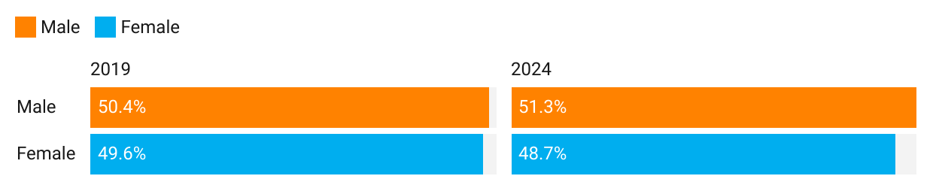
Men and women are similarly prominent in ads
Male and female characters make up about half of all characters on screen in 2024, similar to 2019.
Percent of female and male characters in Indian ads
Notes:
Men and women are similarly prominent in ads
Male and female characters make up about half of all characters on screen in 2024, similar to 2019.

Slide 11
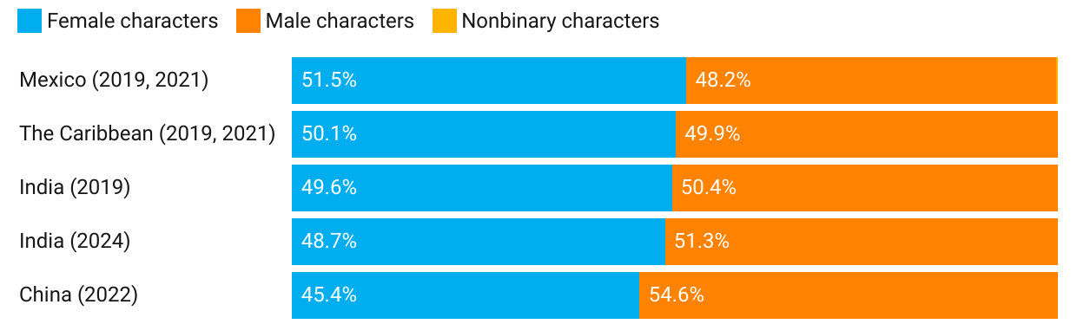
International comparison
Comparison of male, female, and nonbinary characters in ads in India, China, Mexico, and the Caribbean
Notes:
For comparison, similar studies between the Geena Davis Institute and UNICEF have found similar proportions of female characters in countries like China, Mexico, and the Caribbean.
Just 0.3% of characters in the Mexican ads that aired in 2019 and 2021 were nonbinary.

Slide 12
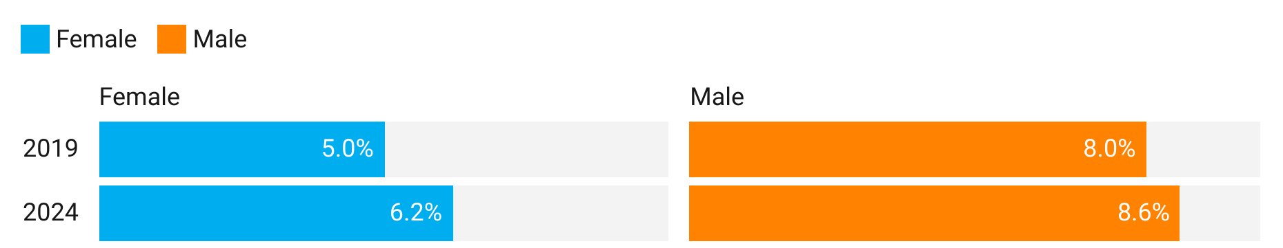
Greater body diversity
Women and men are more likely to larger body size in 2024 than in 2019, pointing to more body diversity for all adults in newers ads.
Proportion of overweight characters by gender
Notes:
Women and men are more likely to be larger body size in 2024 than in 2019, pointing to more body diversity for all adults in newers ads.

Slide 13
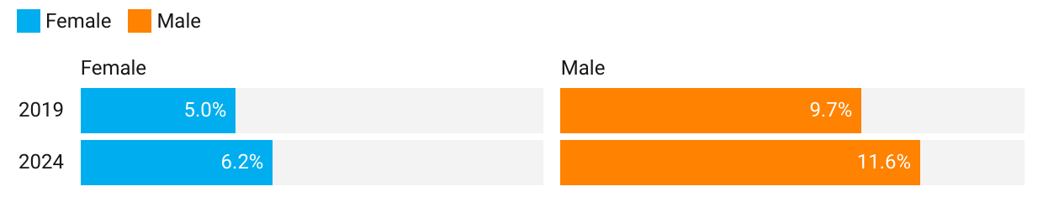
More visibility for 50-plus characters
Both women and men are more likely to be 50-plus in 2024 than in 2019, pointing to more visibility for older adults in newer ads.
Proportion of 50-plus characters by gender
Notes:
Both women and men are more likely to be 50-plus in 2024 than in 2019, pointing to more visibility for older adults in newer ads.

Slide 14
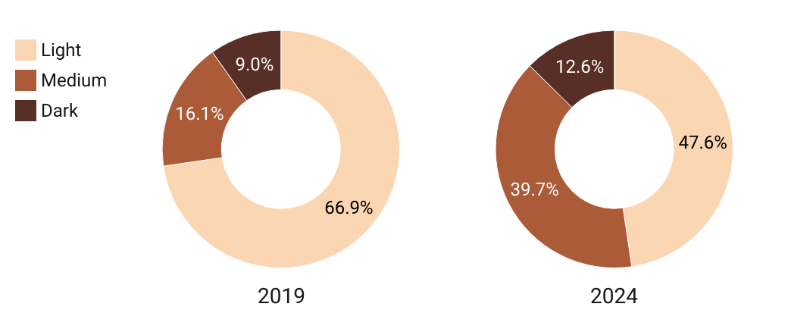
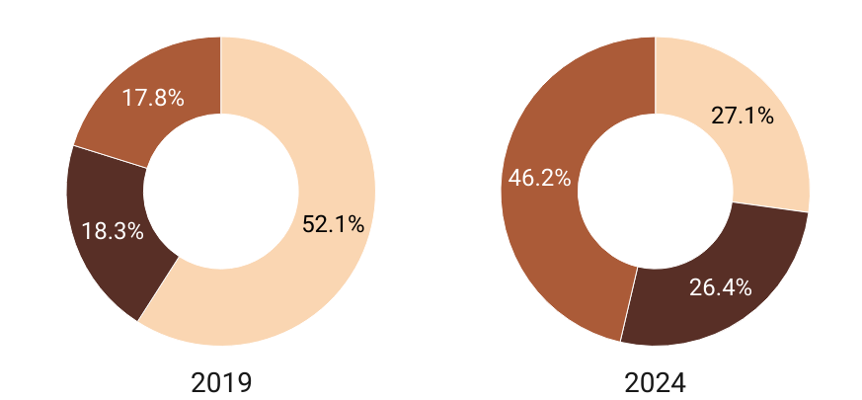
Greater skin tone diversity
In 2024, both female and male characters are more likely to have a medium or dark skin tone than in 2019, suggesting more skin tone diversity in newer ads.
% Female characters % Male characters
Notes:
In 2024, both female and male characters are more likely to have a medium or dark skin tone than in 2019, suggesting more skin tone diversity in newer ads.

Slide 15
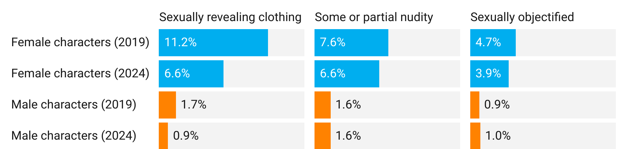
Less sexualization in advertising
Both female and male characters are almost half as likely in 2024 to be depicted in sexually revealing clothing than they were in 2019. There was not an increase in the share of female characters shown in a state of nudity or explicitly objectified from 2019 to 2024.
3.4%
Notes:
Both female and male characters are almost half as likely in 2024 to be depicted in sexually revealing clothing than they were in 2019. There was not an increase in the share of female characters shown in a state of nudity or explicitly objectified from 2019 to 2024.

Slide 16
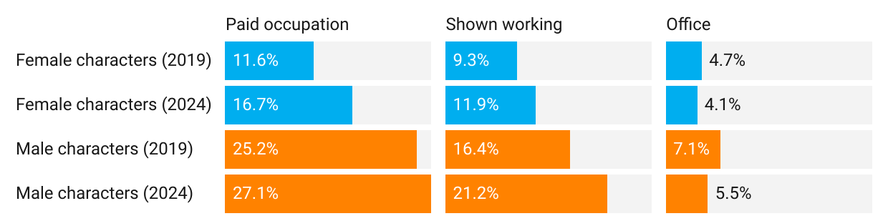
Women in the workforce
Female (and male) characters in 2024 are more likely to have a paid occupation (e.g., doctor, scientist) and be shown working than in 2019. Both female and male characters in 2024 are less likely to be shown in the office than in 2019.
14.6%
Notes:
Female (and male) characters in 2024 are more likely to have a paid occupation (e.g., doctor, scientist) and be shown working than in 2019. Both female and male characters in 2024 are less likely to be shown in the office than in 2019.

Slide 17
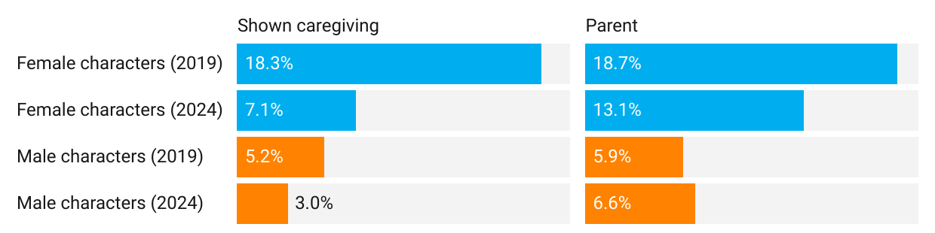
Sharing the caregiving load
From 2019 to 2024, the parenting gender gap closed from 12.8 points to 6.5 points. The gender gap also closed for characters shown caregiving (from 13.1 points in 2019 to 4.1 points in 2024).
Notes:
From 2019 to 2024, the parenting gender gap closed from 12.8 points to 6.5 points. The gender gap also closed for characters shown caregiving (from 13.1 points in 2019 to 4.1 points in 2024).

Slide 18
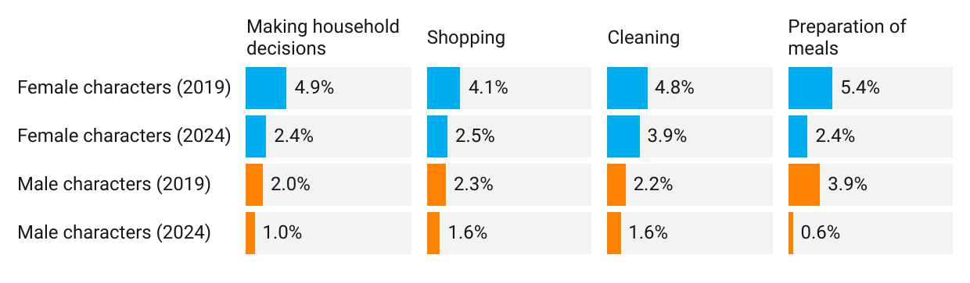
Sharing the caregiving load
Almost half as many female characters in 2024 were shown making household decisions and preparing meals than in 2019; this may suggest that women are shown less in ads solely as caregivers and in domestic roles.
Notes:
While almost half as many female characters in 2024 were shown making household decisions and caregiving than in 2019, this may suggest that women are shown less in ads solely as caregivers and in domestic roles.

Slide 19
Takeaway from key wins
Representation in Indian ads has become more diverse and less stereotyped.
Women and men appear equally often, with increases in body diversity, older adults, and darker skin tones on screen. Sexualization has dropped for both. Gender norms are less prevalent, with women more likely to be shown working, and men more often appearing as parents.

Slide 20
Opportunities For Improvement

Slide 21
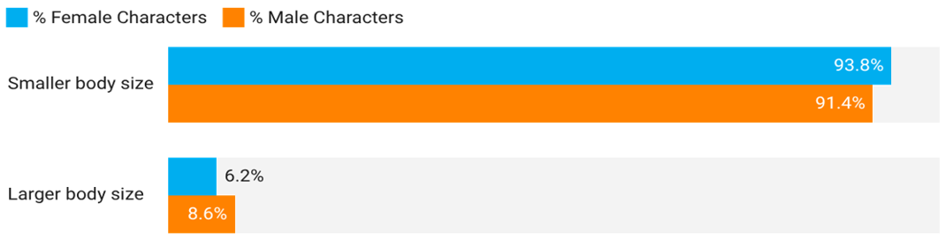
Women are less likely to be larger body size
While very few characters are shown to have larger body size , female characters are less likely than male characters to be bigger built in 2024.
Character Gender by Body Size in 2024 Indian Ads
Notes:
While very few characters are shown to be larger body size and smaller body size, female characters are less likely than male characters to be % lager body size in 2024.

Slide 22
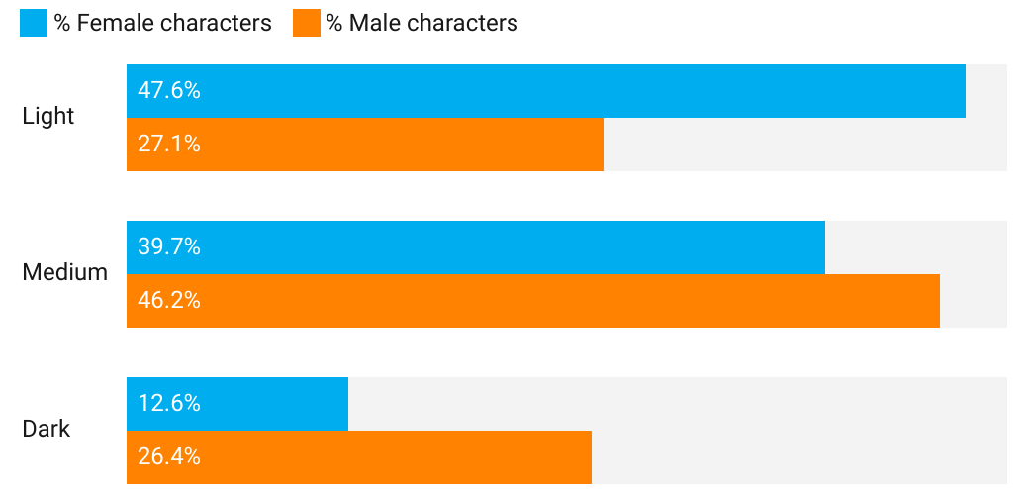
Female characters have less diverse skin tone
In 2024, female characters are more likely than male characters to have a lighter skin tone (47.6% compared with 27.1%).
Notes:
In 2024, female characters are more likely than male characters to have a lighter skin tone (47.6% compared with 27.1%).

Slide 23
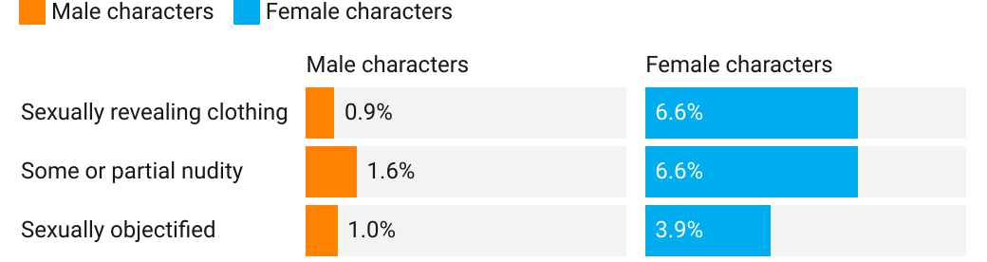
Women are still sexualized more often than men
In 2024, female characters are still seven times more likely to wear sexually revealing clothing, four times more likely to be shown in some or partial nudity, and almost four times more likely to be sexually objectified than male characters.
3.4%
Notes:
In 2024, female characters are still seven times more likely to wear sexually revealing clothing, four times more likely to be shown in some or partial nudity, and almost four times more likely to be sexually objectified than male characters.

Slide 24
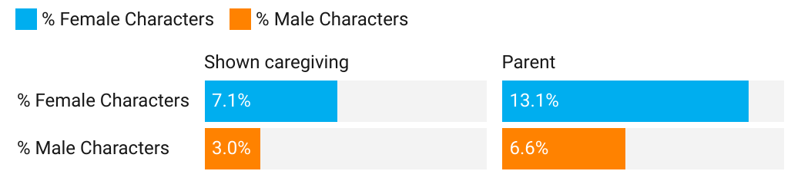
Care responsibilities are still gendered
Although the gaps in 2024 are smaller than in 2019, female characters are still at least two times more likely than male characters to be shown caregiving and as a parent.
Notes:
Although the gaps in 2024 are smaller than in 2019, female characters are still at least two times more likely than male characters to be shown caregiving and as a parent.

Slide 25
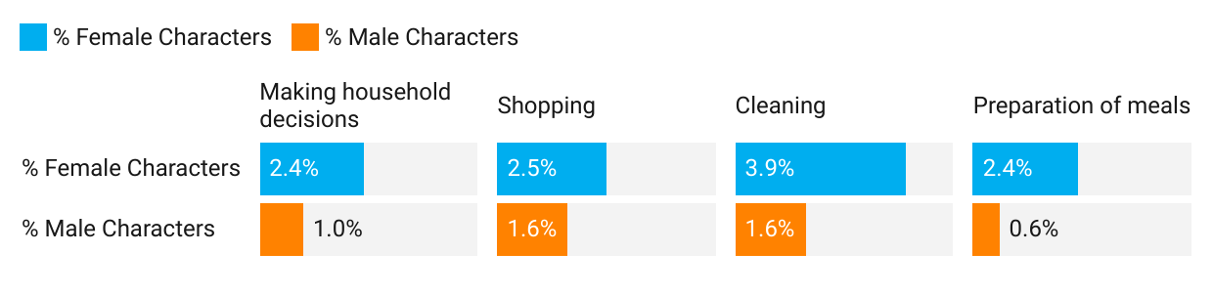
Unequal distribution of
domestic responsibilities
In 2024, female characters were almost two times more likely than male characters to be shown making household decisions, shopping, cleaning, and preparing meals.
Notes:
In 2024, female characters were almost two times more likely than male characters to be shown making household decisions, shopping, cleaning, and preparing meals.

Slide 26
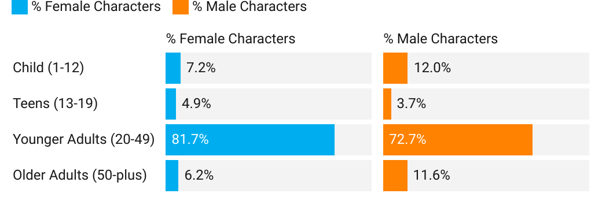
Men are more likely to be
shown as 50-plus
Male characters are more likely to be 50-plus than female characters in 2024 (11.6% compared with 6.2%).
Notes:
Male characters are more likely to be 50-plus than female characters in 2024 (11.6% compared with 6.2%).

Slide 27
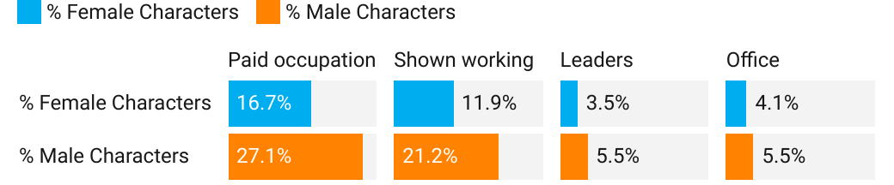
Men still dominate in workplace & leadership roles
Although the gender gaps are smaller in 2024 than 2019 ads, male characters are still more likely than female characters to be shown in a paid occupation, shown working, shown as leaders, and shown in the office.
14.6%
Notes:
Although the gender gaps are smaller in 2024 than 2019 ads, male characters are still more likely than female characters to be shown in a paid occupation, shown working, shown as leaders, and shown in the office.

Slide 28
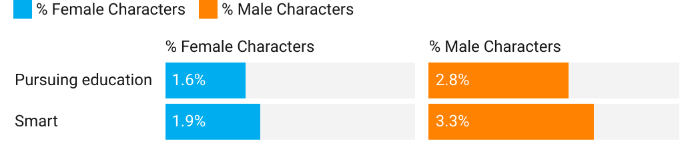
Men are shown as smart and pursuing their education
Although the gaps are smaller in 2024 compared to 2019, male characters are still 1.5 times more likely than female characters to be shown pursuing their education and 1.7 times more likely to be shown as smart in 2024.
Notes:
Although the gaps are smaller in 2024 compared to 2019, male characters are still 1.5 times more likely than female characters to be shown pursuing their education and 1.7 times more likely to be shown as smart in 2024.

Slide 29
Takeaway from key opportunities for improvement
Although smaller, gender gaps persist in Indian ads.
Women are still more often sexualized, more often placed in domestic roles, and more commonly shown with lighter skin tones. Men continue to dominate workplace and leadership roles, appear more often as older adults, and are more frequently portrayed as pursuing education.

Slide 30
Recommendations

Slide 31
What can the Industry do?
Strive for gender parity across all advertisements, and ensure that both men and women have speaking roles.
Think intersectionality when casting. For example, cast more women who are older. Cast more girls and women with a dark skin tone. Cast more girls and women and girls with large body types.
Reduce the sexualization of girls and women. Ways to do this is thinking critically about sexually revealing clothing, and refrain from camera angles that focus or zoom in on sexual body parts.
Be attentive to gender stereotypes and tropes, and actively work to counter them across ads, especially for girls and women, such as occupational tropes, or roles in domesticity scenes.
Notes:
Strive for gender parity across all advertisements, and ensure that both men and women have speaking roles. Set internal standards for the representation of female and male characters.
Think about intersectionality when casting. For example, cast more women who are older. Cast more girls and women with dark skin tones. Cast more girls and women and girls with large body types.
Reduce the sexualization of girls and women. Think critically about depicting characters in sexually revealing clothing, and refrain from camera angles that focus or zoom in on sexual body parts.
Be attentive to gender stereotypes and tropes, and actively work to counter them across ads, especially for girls and women, such as occupational tropes or roles in domestic scenes. Use resources, like those from UNICEF, that describe persistent gender stereotypes perpetuating harmful gender norms. To accomplish this, refer to UNICEF’s resources to help in creating ads that challenge stereotypes. Specific subjects include the areas of marriage, wherein marriage is not the sole interest of female characters but is instead something male characters fantasize about, and education, where female characters are also seen pursuing learning.

Slide 32
What can the Industry do?
Show more girls and women in work and leadership roles. Ways to do this are by showing them with a paid occupation, pursuing an education, actively working in their job, and as leaders.
Cast more female characters in comedic ads, where the female characters are carrying the narrative.
Show more men in domestic roles. Ways to do this are by showing them making household decisions, and showing them in a caregiving role, shopping, cleaning, and preparing meals for their families.
Notes:
Show more girls and women in work and leadership roles. Show them with a paid occupation, pursuing an education, actively working in their job, and as leaders (e.g., making decisions, giving orders, having a leadership role at work).
Cast more female characters in comedic ads, where the female characters are carrying the narrative, to overcome the gender imbalance in who is shown as funny.
Show more men in domestic roles. Show them making household decisions and in caregiving roles, shopping, cleaning, and preparing meals for their families. Such portrayals help challenge the stereotype that men do not belong in domestic spaces, and help normalize shared household responsibilities.
Refer to advertisements that successfully challenge stereotypes as a starting point for content creation. For instance, Vim Liquid’s advertisement that featured men taking on kitchen roles or Harley Davidson’s advertisement that featured a woman riding a Harley.
Overall, the findings suggest much progress when comparing 2019 ads to 2024 ads, as well as some in gender representation disparities that remain in Indian advertising.
The most positive sign of improvement is smaller gender gaps in nearly every domain analyzed. Namely, more male characters shown as fathers is bridging the parenting gap, and fewer women in sexually revealing clothing is reducing portrayals that objectify female characters. Additionally, male and female characters were equally shown in outdoor settings and making personal decisions about the future.
At the same time, while these gaps largely declined, female characters are still significantly more likely than male characters to appear in caregiving and domestic roles, and male characters are still significantly more likely to be shown in a paid occupation and workplace.
These patterns highlight that while some progress has been made toward more balanced portrayals, significant work remains to challenge gender norms and ensure equitable representation in Indian ads.

Slide 33

Thank you!
To read the full report, scan the QR code above or see www.unicef.org/india/research-reports

Slide 34
for every child
Published by the Geena Davis Institute, UNICEF India, and the International Advertising Association - India
gmaster@unicef.org
www.unicef.org/india/research-reports
Cover Photo by Pragyan Bezbaruah on Pexels: https://www.pexels.com/photo/smiling-girl-in-shirt-sitting-on-stairs-18094984/
© United Nations Children’s Fund (UNICEF)
& the Geena Davis Institute, November 2025

